Slide 1

Opportunities in Improving Product Sales
March 5 2022
Oleksandra Aliyeva

Slide 2
Understanding the properties of products and outlets that play crucial roles in increasing sales.
Problem Statement:

Slide 3
General Information About Stores
Type of Outlet | Number of Stores
Supermarket Type1 | 5577
Grocery Store | 1083
Supermarket Type3 | 935
Supermarket Type2 | 928
The type of area in which the store is located | Number of Stores
Tier 3 | 3350
Tier 2 | 2785
Tier 1 | 2388
Outlet Identifier | Number of Stores
OUT027 | 935
OUT013 | 932
OUT049 | 930
OUT046 | 930
OUT035 | 930
OUT045 | 929
OUT018 | 928
OUT017 | 926
OUT010 | 555
OUT019 | 528

Slide 4
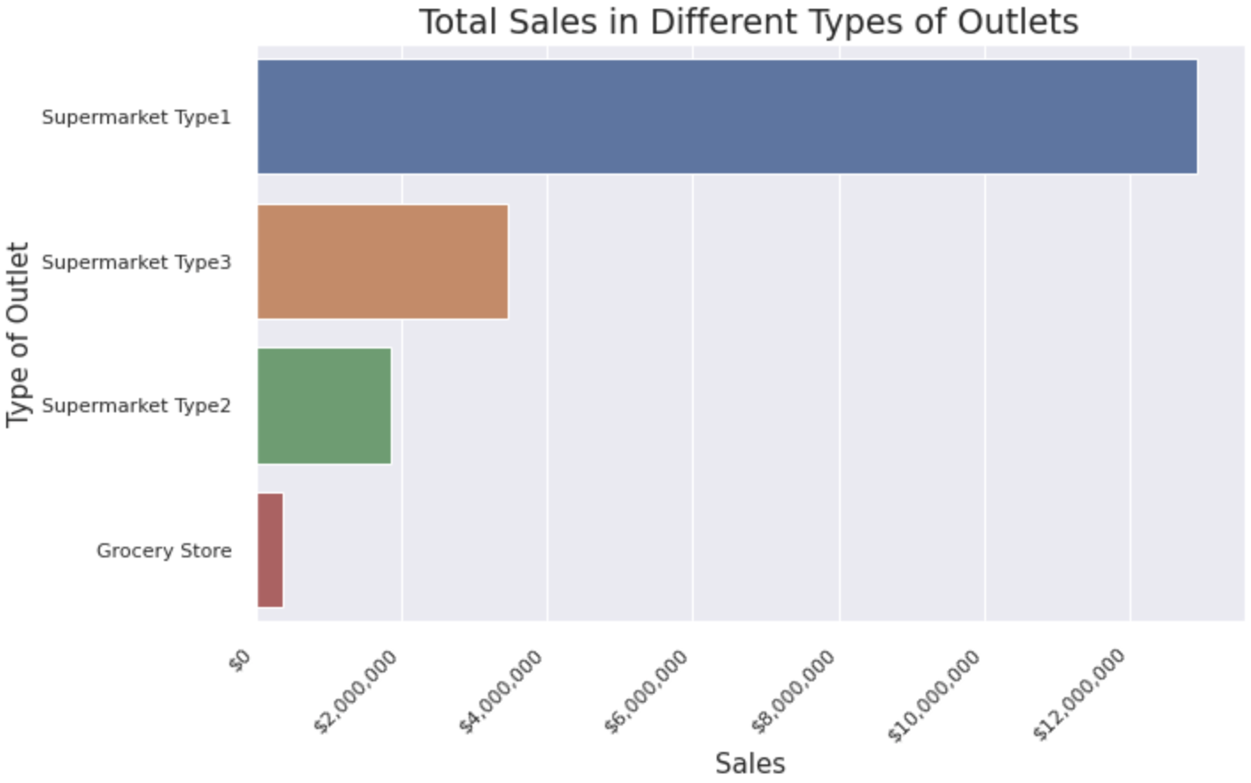
Gross Sales Analysis
Highest total sales has Supermarket Type 1 – $12,917,340
Lowest total sales has
Grocery Store – $368,034

Slide 5
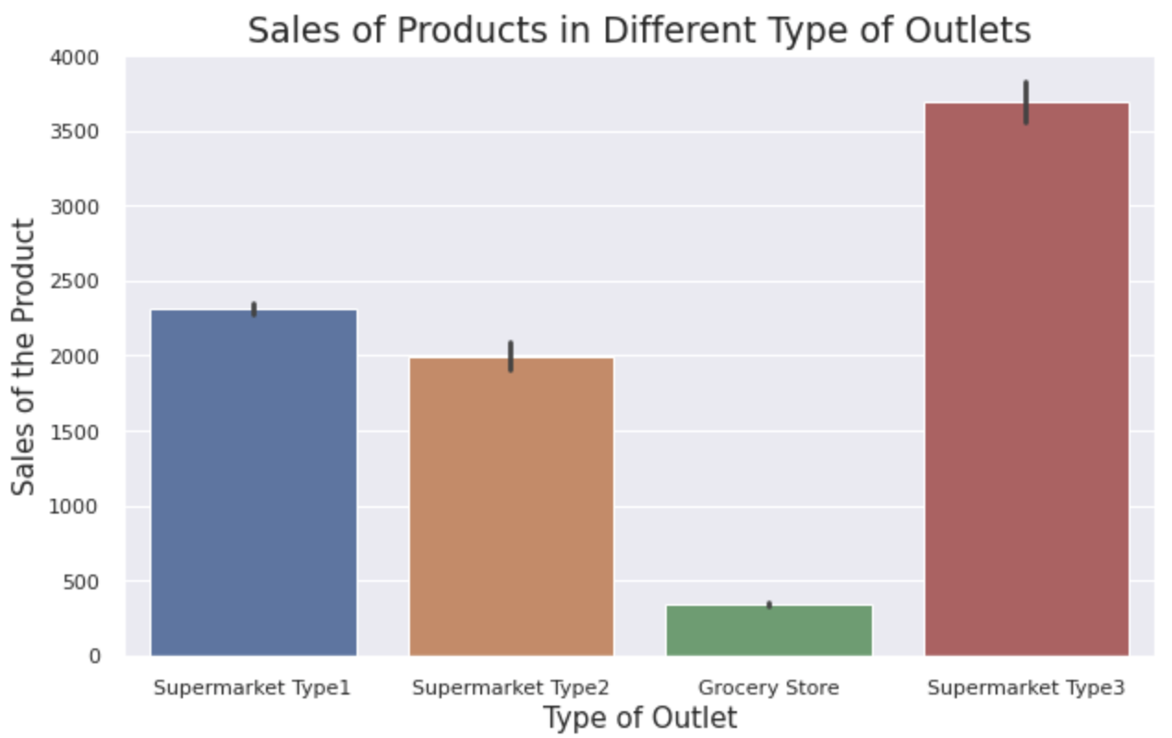
Average Sales In Different Outlet Types
Highest Sales of Products
has Supermarket Type 3.
It is
37% more than Supermarket Type 1.
46% more than Supermarket Type 2
91% more than Grocery Store

Slide 6
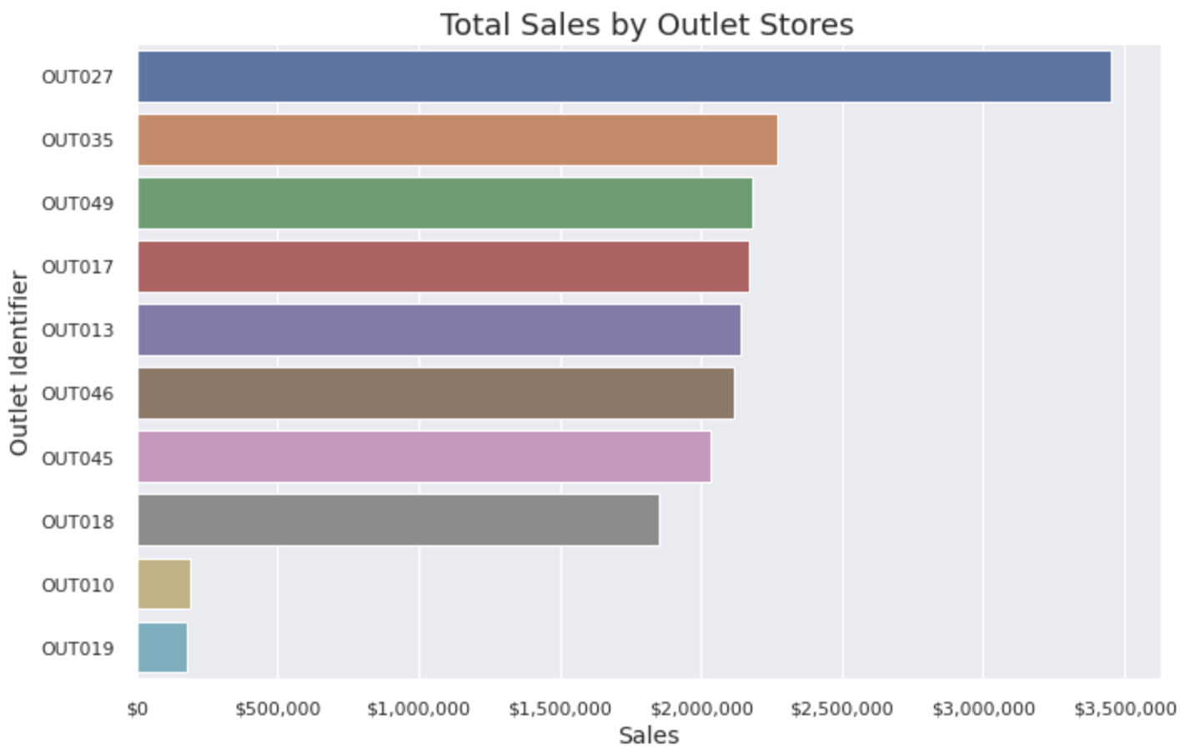
Comparison of Gross Sale in Different Stores
OUT027 has $ 3,453,926 of total sales.
This store is from Outlet Type –
Supermarket Type 3.
It’s location is Tier3.
Conclusion: The most effective sale produced
in Supermarket Type 3, that located in Tier3 area
and belongs to Outlet Store - OUT027.

Slide 7
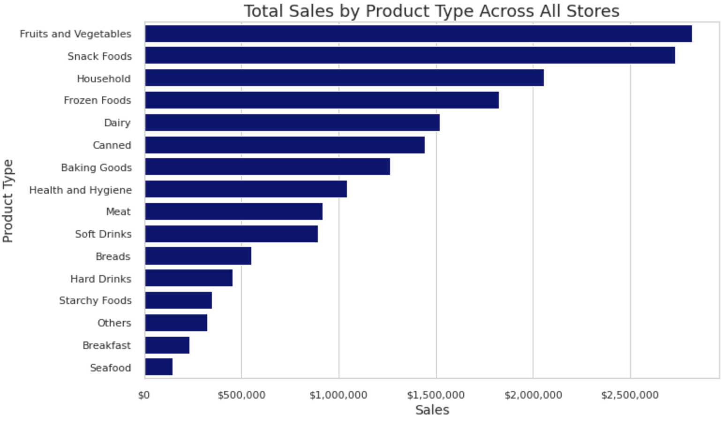
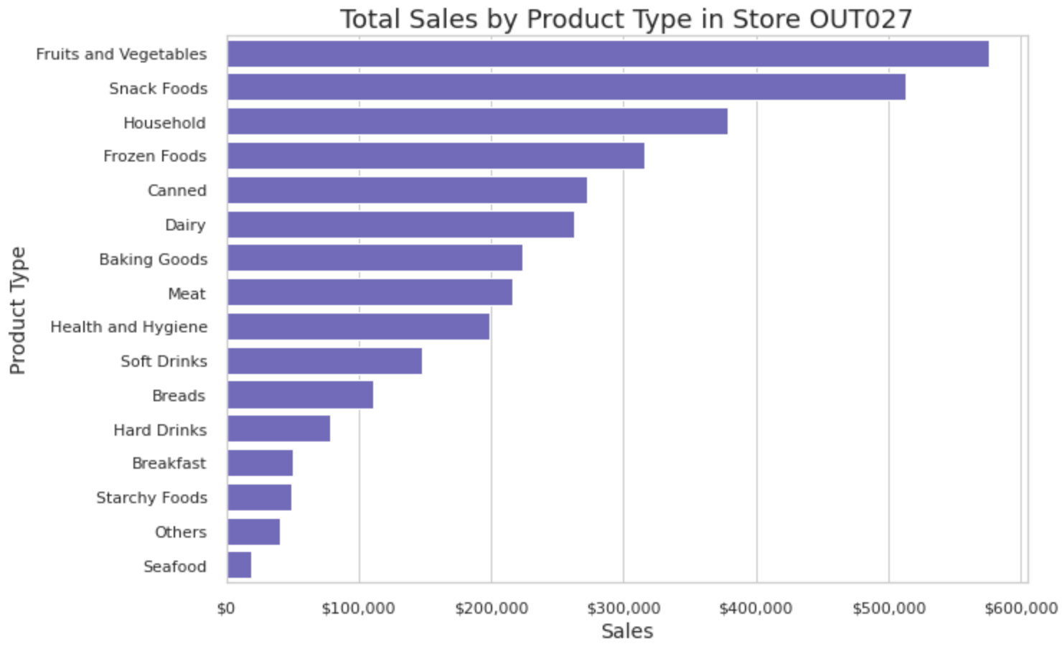
Comparison of Gross Sales by Product
Type Across All Stores and Store OUT027

Slide 8
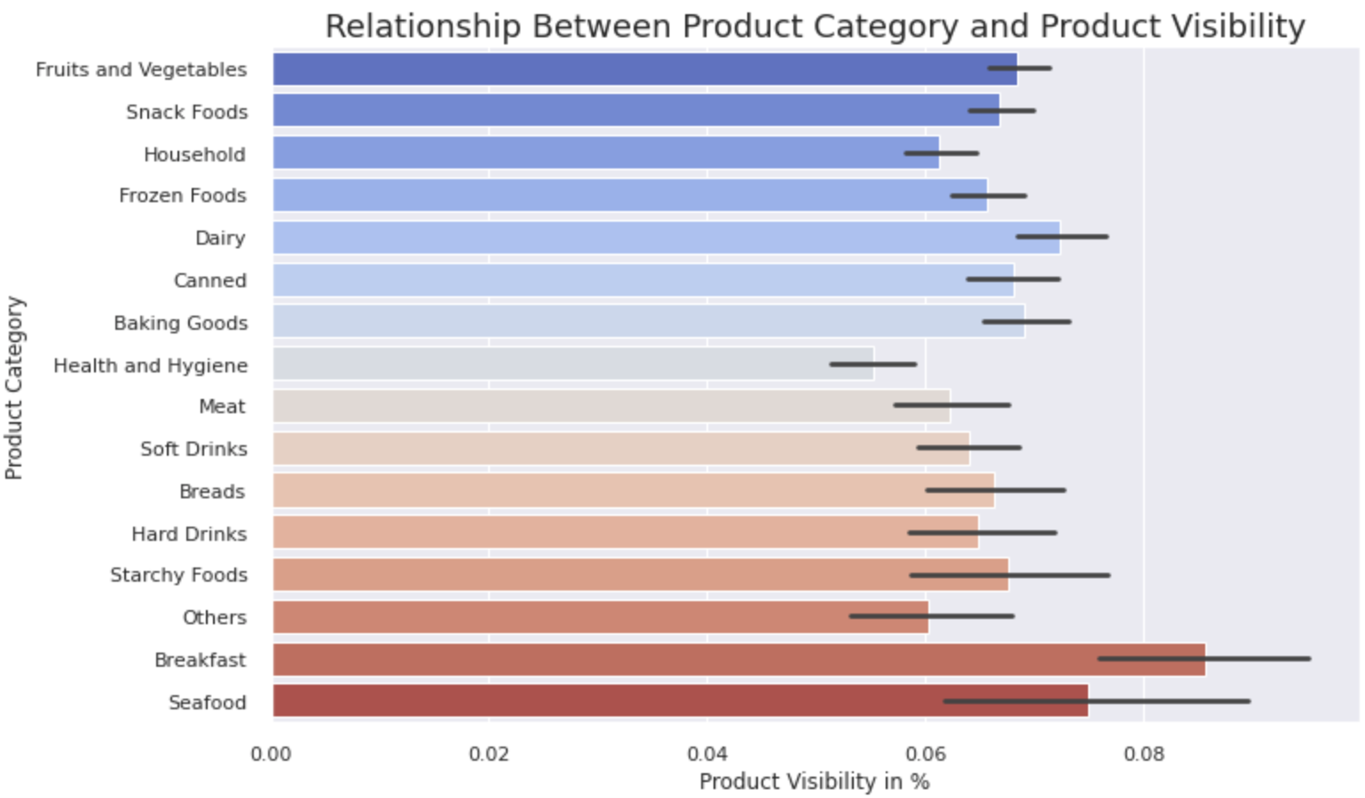
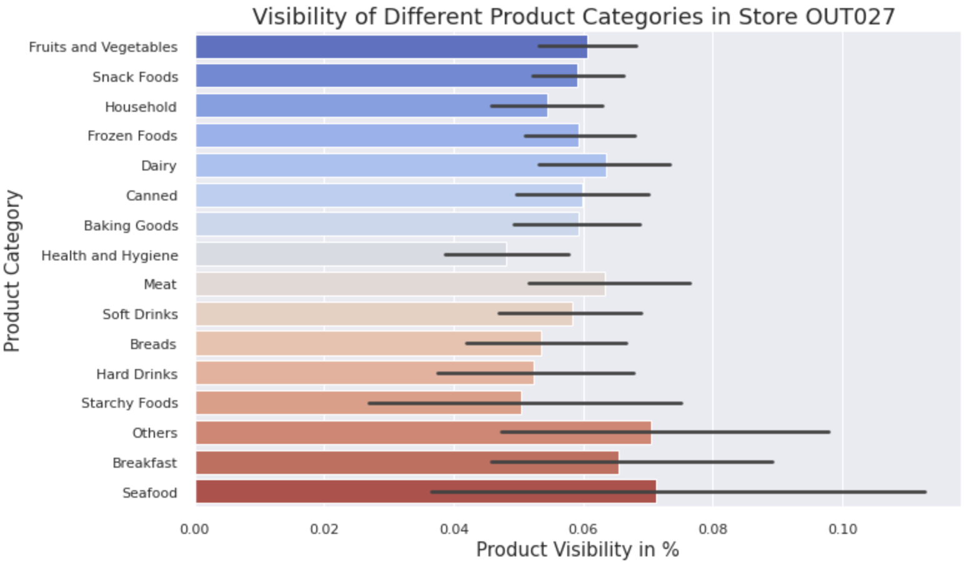
Visibility comparison of Product Categories in all stores and in Store OUT027
Most of the Product Categories in Store OUT027 have less visibility that average in all stores.

Slide 9
Recommendations
Increase the amount of Supermarket Type 3 Outlets located in Tier3
Continue analysis of sales as per product type in order to find opportunities in sales growth.
Implement a visibility scheme used in Store OUT027 in a couple stores to see if it helps to increase the sales.

Slide 10
Thank you

